Slide 1
Excel and Google Sheets for Web Scraping
Dr. Anil Shrestha
Undersecretary (Account)
Financial Administration Section
National Statistics Office

Slide 2
Pros and Cons

Slide 3

Pros & Cons
Pros
User-friendly and accessible, especially for non-coders.
No need to write complex code, saving time and resources.
Built-in features make cleaning and organizing data simple and quick.
Cons
May not be suitable for large-scale or complex data extraction projects.
Limited customization and control compared to coding from scratch.
Not suitable for dynamic websites.
Could be slow for processing large amounts of data.

Slide 4
Excel’s Web Query

Slide 5
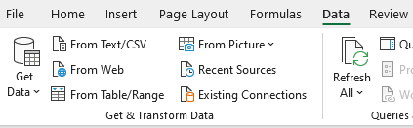
Web Query in Excel
Let’s scrap share price from https://www.sharesansar.com/today-share-price using Excel’s web query feature.

Slide 6
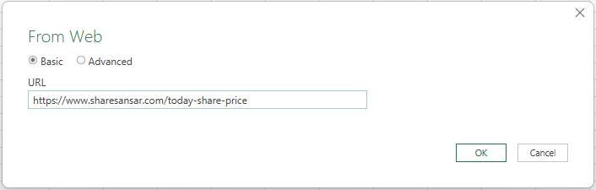
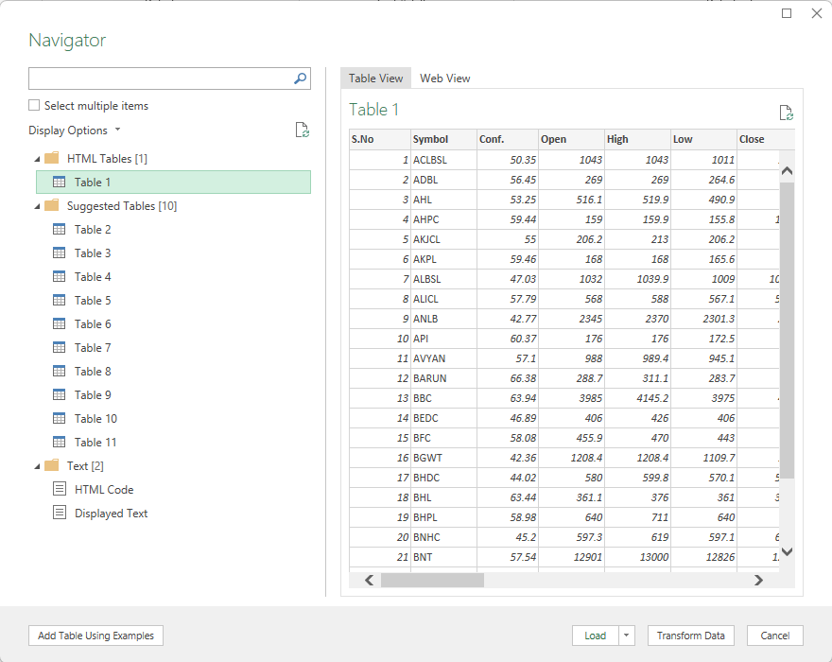

Slide 7
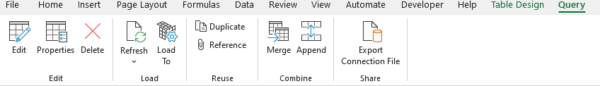
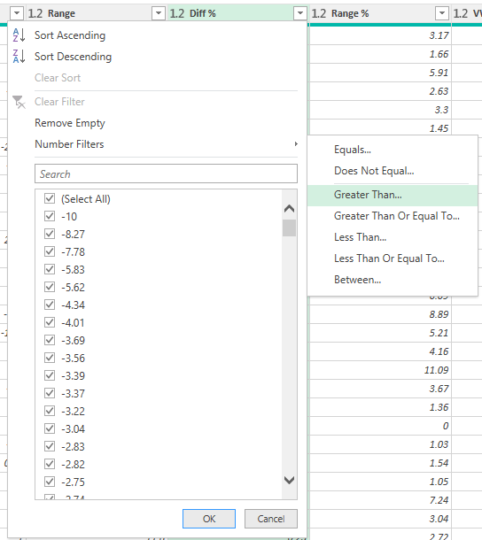
Suppose we are only interested in upper and lower circuit stocks (i.e. price change >9% or <-9%). Let’s scrap the data based on these rules.

Slide 8
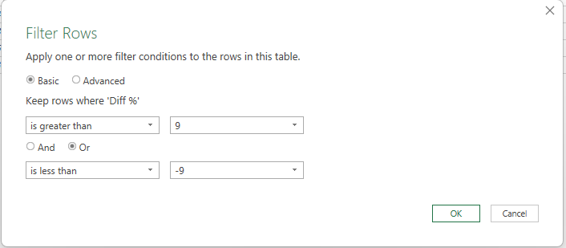
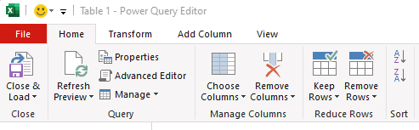

Slide 9
Web scraping Google Sheets

Slide 10

Benefits of using Google Sheets
Faster and simpler than excel web scraping.
Multiple built-in web scraping functions (e.g., IMPORTDATA, IMPORTHTML, IMPORTXML)
Stores in the cloud and easier to share/collaborate.
Auto updating and no need to manually refresh like in Excel.

Slide 11
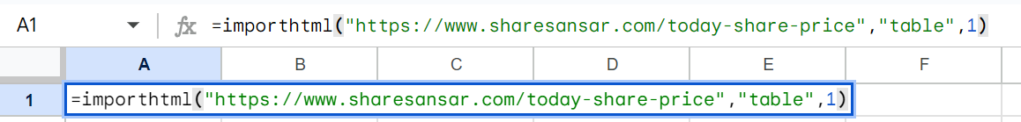
Let’s scrap share price from https://www.sharesansar.com/today-share-price using Google Sheets.
Open any browser and enter sheet.new in the address bar.
Log in with your google account (if not logged in).
Give a name to the sheet. (Sheet will be stored in google drive)

Slide 12
Let's filter the upper and lower circuit stocks (i.e. price change >9% or <-9%). For this, we need to embed IMPORTHTML function inside QUERY function.

Slide 13
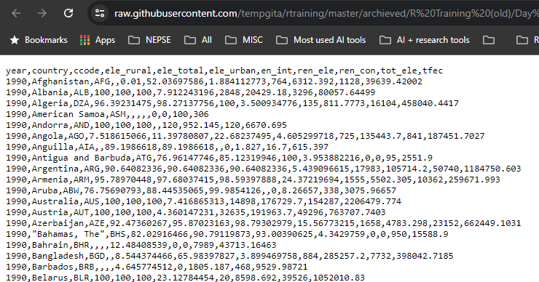
Scraping CSV data
Sometimes, data is available in CSV format. We can import CSV data directly to Google Sheet using IMPORTDATA function.
For example, open the URL http://s.anilz.net/wb_energy

Slide 14
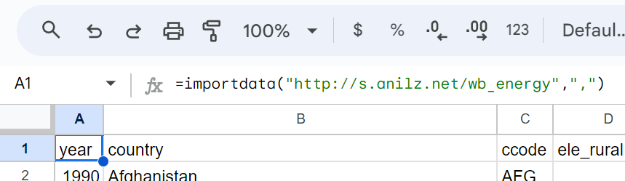

Slide 15
Scraping specific values
If we are interested in a specific values than a set of data, we can use IMPORTXML function.
Suppose we are interested in Buy and Sell rates of USD from https://www.nrb.org.np/. To extract the Buy and Sell rates of USD, we need to extract the XPATH of the required values to be used in IMPORTXML function.

Slide 16
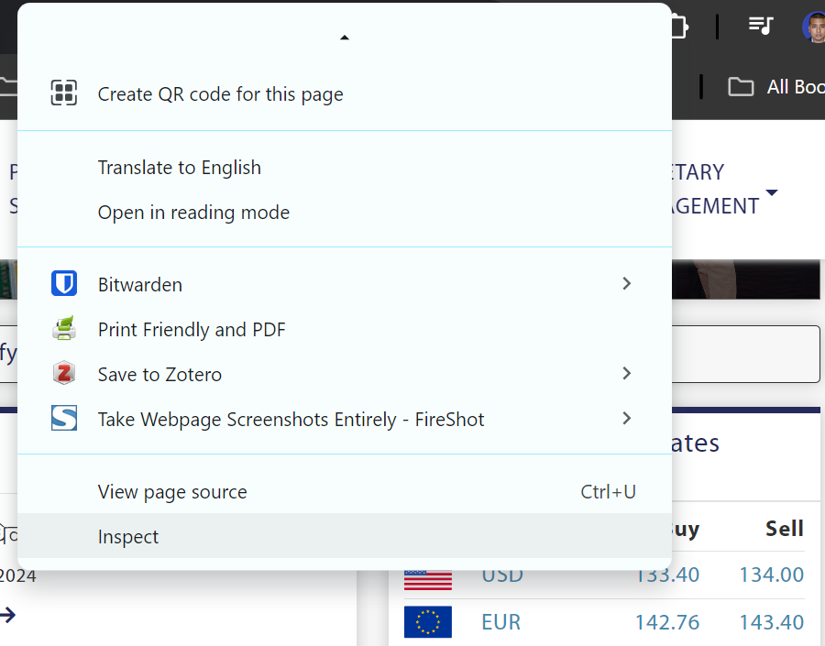
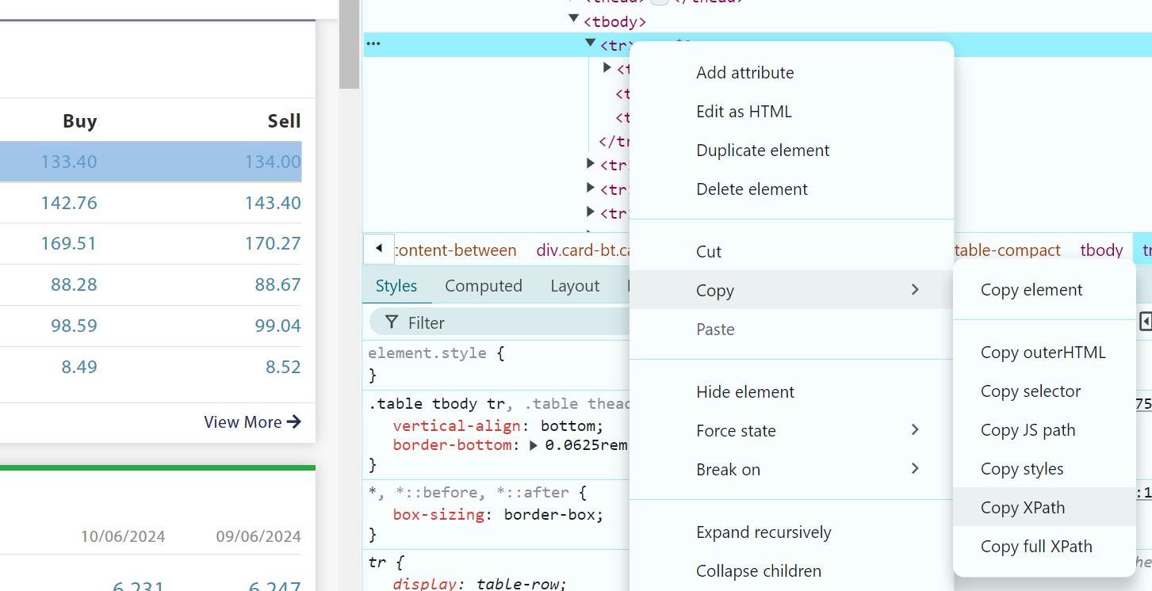
<= Can also use Ctrl + Shift + C to inspect element.

Slide 17
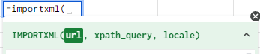

Instead of a fixed XPATH, we can also use a conditional XPATH for dynamically scraping exchange rate for a particular currency.

Slide 18
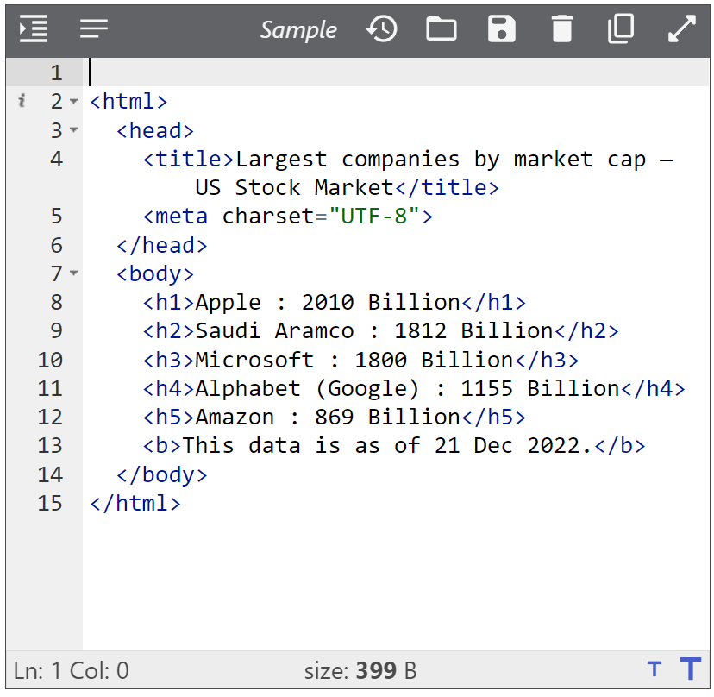
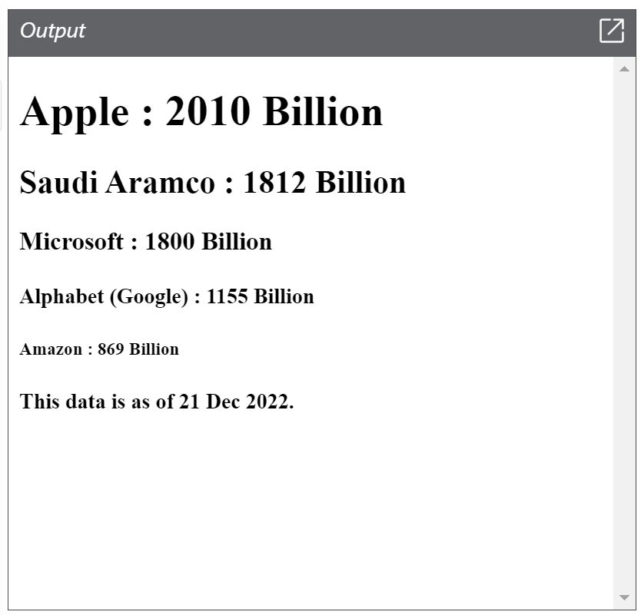
Short intro to XPATH
A website is made up of HTML code. HTML is a specific type of XML code.

Slide 19
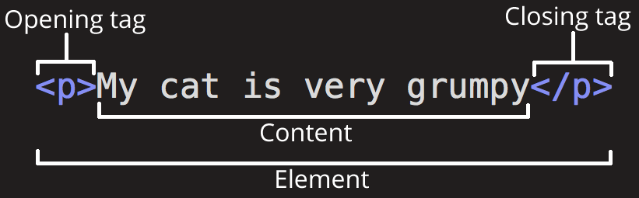
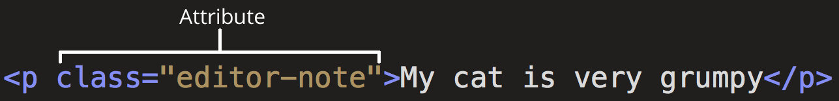

Slide 20
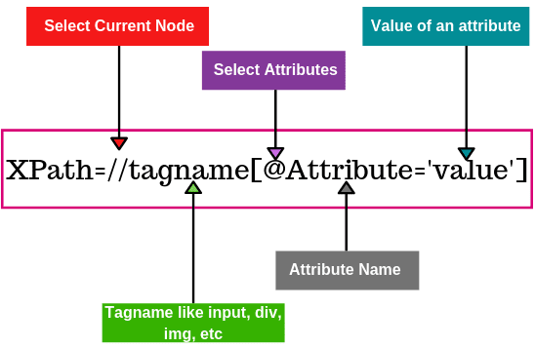
For details, visit https://devhints.io/xpath

Slide 21
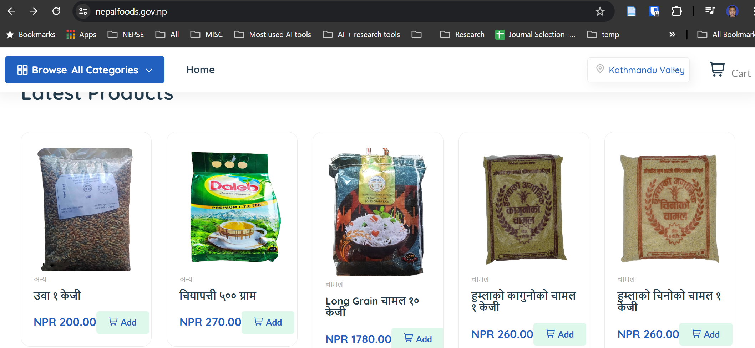
Let's scrap a shopping site
Go to https://nepalfoods.gov.np/ and scrape listed product names and prices.

Slide 22
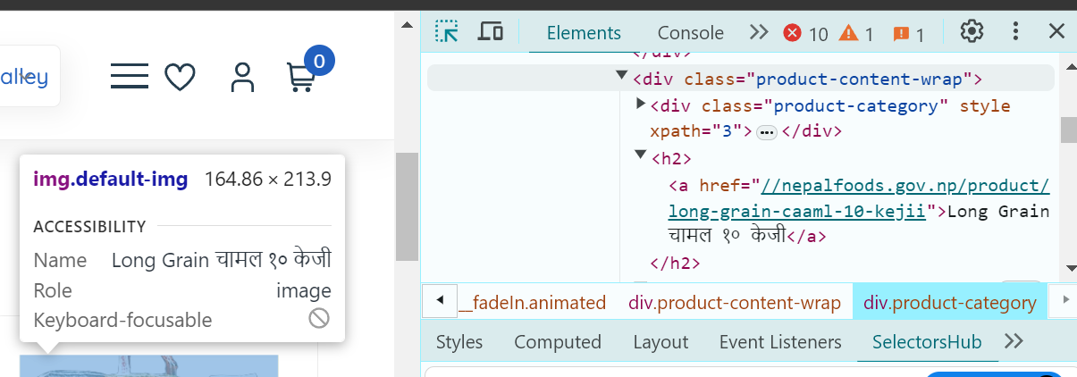

Slide 23
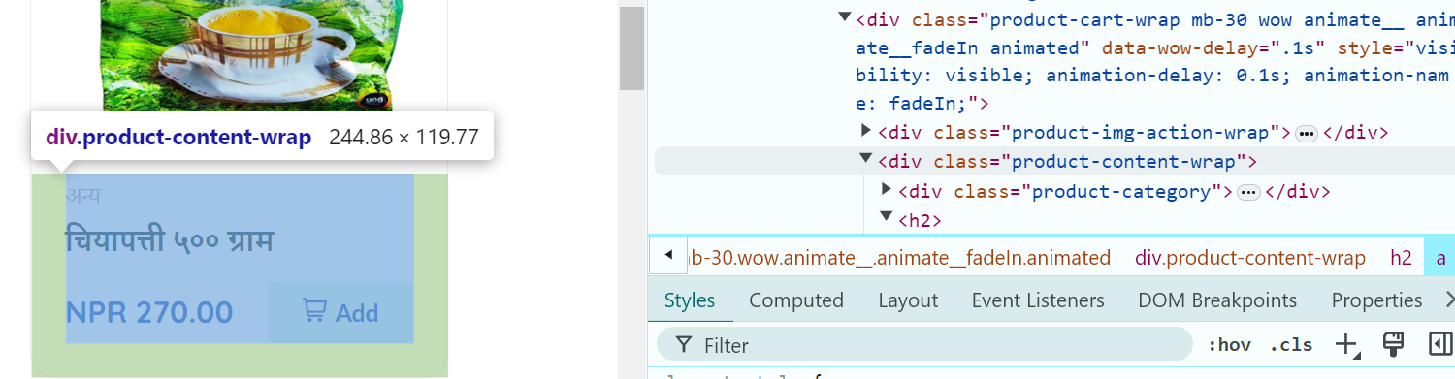

Slide 24
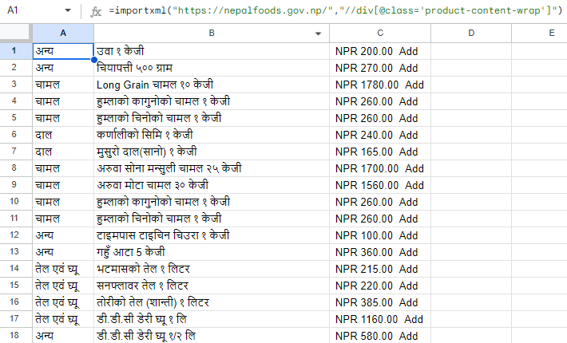

Slide 25


XPATH finding tool
Install the following two Extensions (tools) for chrome browser for easier XPATH finding from Chrome web store (https://chromewebstore.google.com)
https://xml.onlineviewer.net for viewing HTML or XML codes for visual inspection.

Slide 26
SelectorGadget is good for visually selecting elements in group.
Not suitable for individual element selection.
- SelectorsHub is good for visualizing individual or group of element selection.
- Flexible and can try custom XPATH with visualization feature.

Slide 27
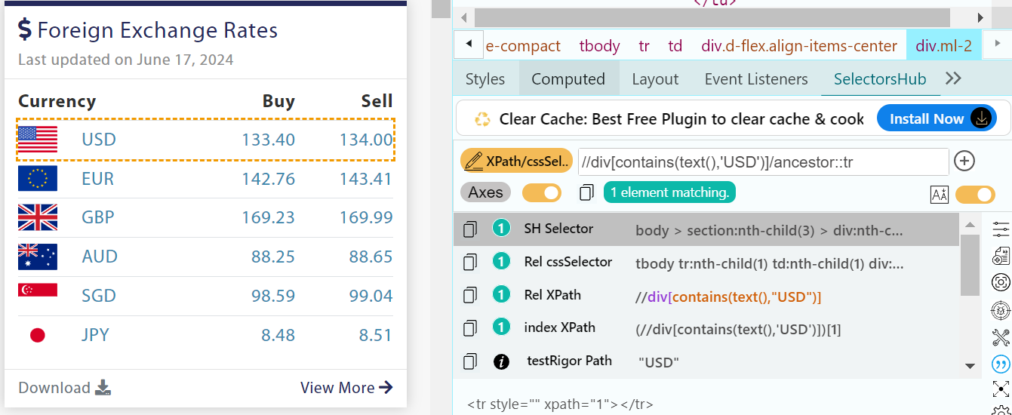
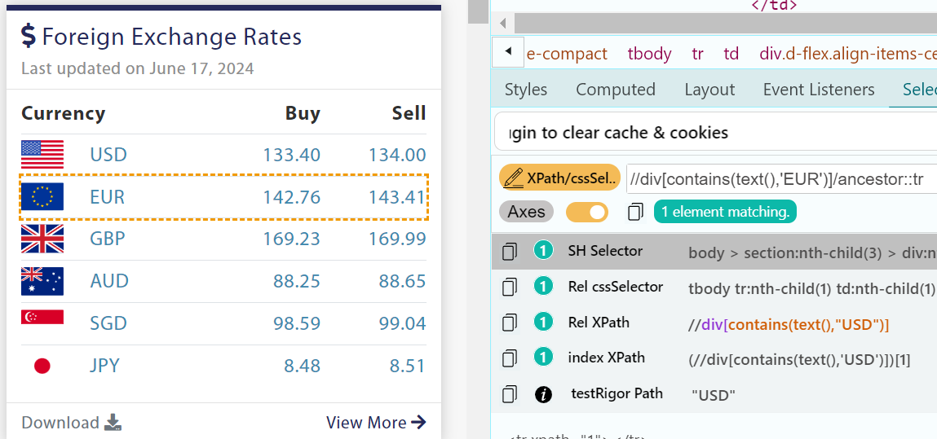
Let’s use SelectorsHub to https://www.nrb.org.np to make custom XPATH and visualize them.

Slide 28
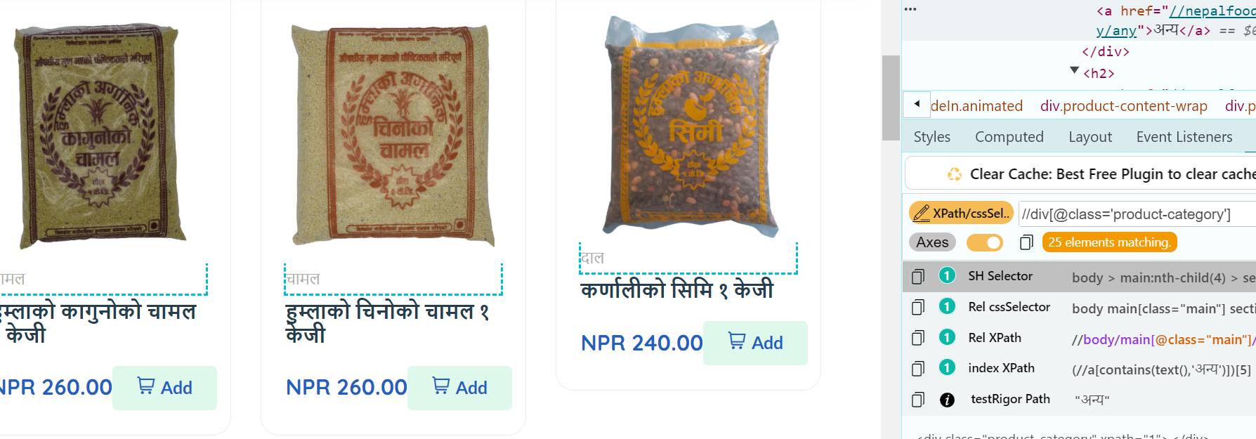
Let’s use SelectorsHub to https://nepalfoods.gov.np to make custom XPATH and visualize them. 25 elements are matched and matched elements are highlighted in dotted lines.

Slide 29
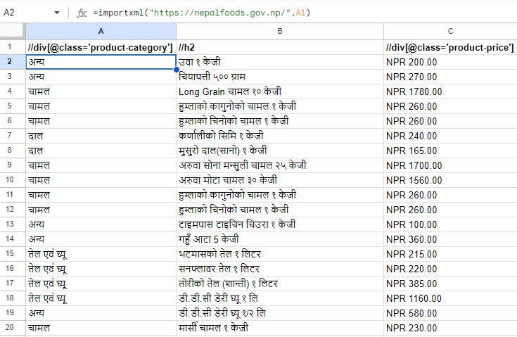

Slide 30
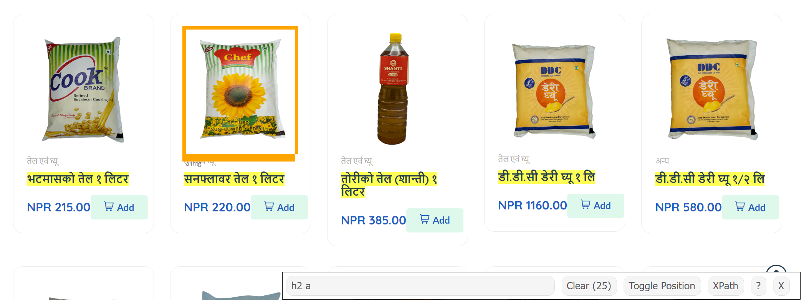
Let’s use SelectorGadget to https://nepalfoods.gov.np to select elements in group.

Slide 31
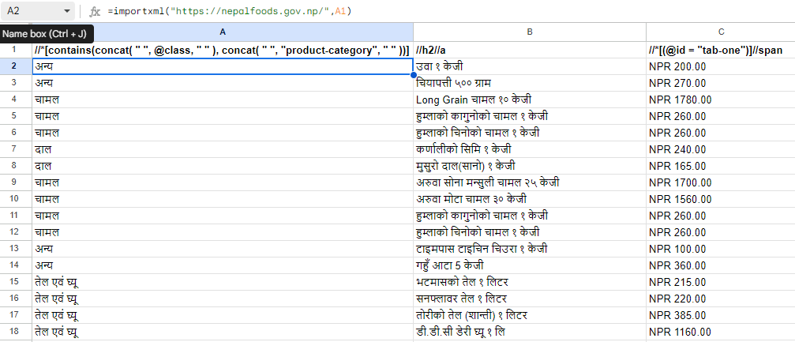

Slide 32
Thank you

